Slide 1


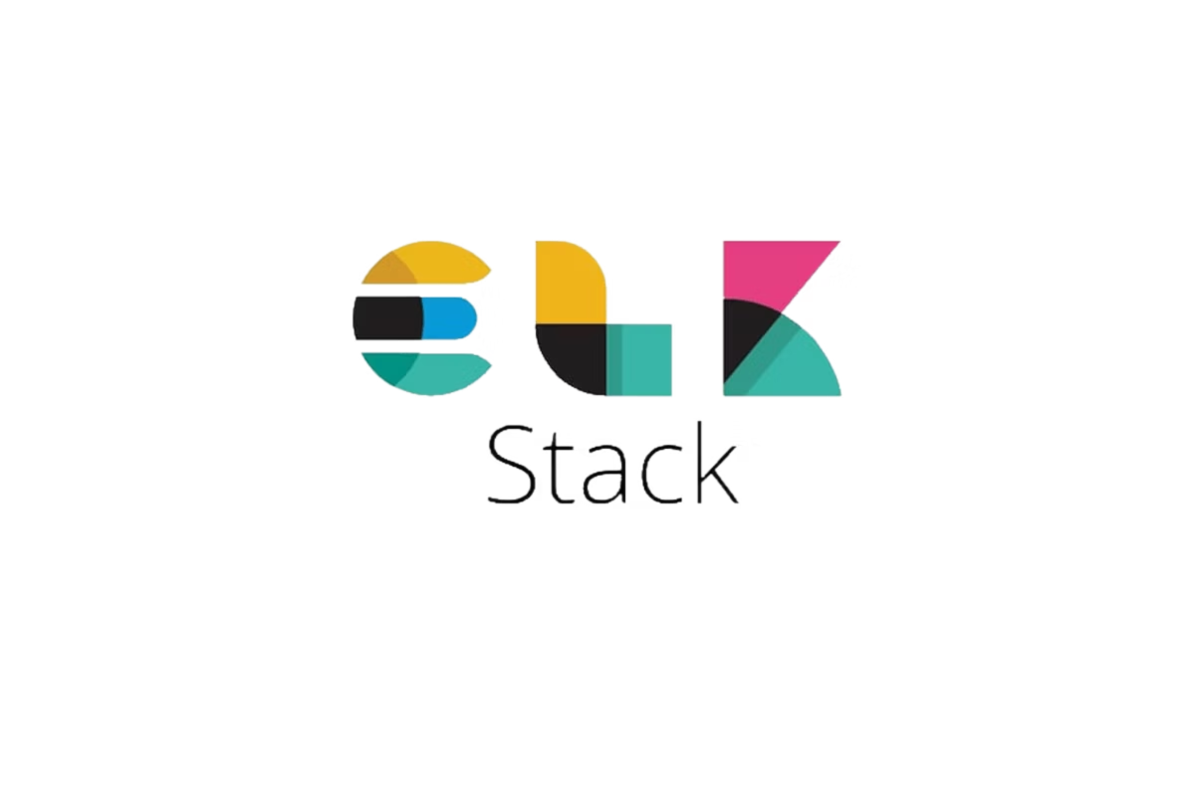
Monitoring & Log Analysis with ELK Stack and CloudWatch
A comprehensive guide to centralised logging and observability for DevOps teams
www.herovired.com

Slide 2

Why Monitoring & Logs are Critical
Every system action generates valuable log data. These logs serve as the foundation for maintaining system health, detecting anomalies, and ensuring security compliance.
Effective monitoring transforms raw log data into actionable insights, enabling teams to identify errors, diagnose performance bottlenecks, and respond to security events before they escalate.
Monitoring equals reliability plus faster debugging – reducing mean time to resolution (MTTR) and preventing costly downtime.

Slide 3



What is the ELK Stack?
The ELK Stack is a powerful open-source platform for centralised log management and analysis, comprising three core components working in harmony.
Elasticsearch
Logstash
Kibana
Distributed search and analytics engine that stores and indexes log data for lightning-fast queries.
Data processing pipeline that collects, parses, transforms, and enriches logs from multiple sources.
Visualisation layer providing interactive dashboards, real-time monitoring, and powerful search capabilities.
Together, these components create a centralised log analysis platform capable of handling millions of log events per second.

Slide 4

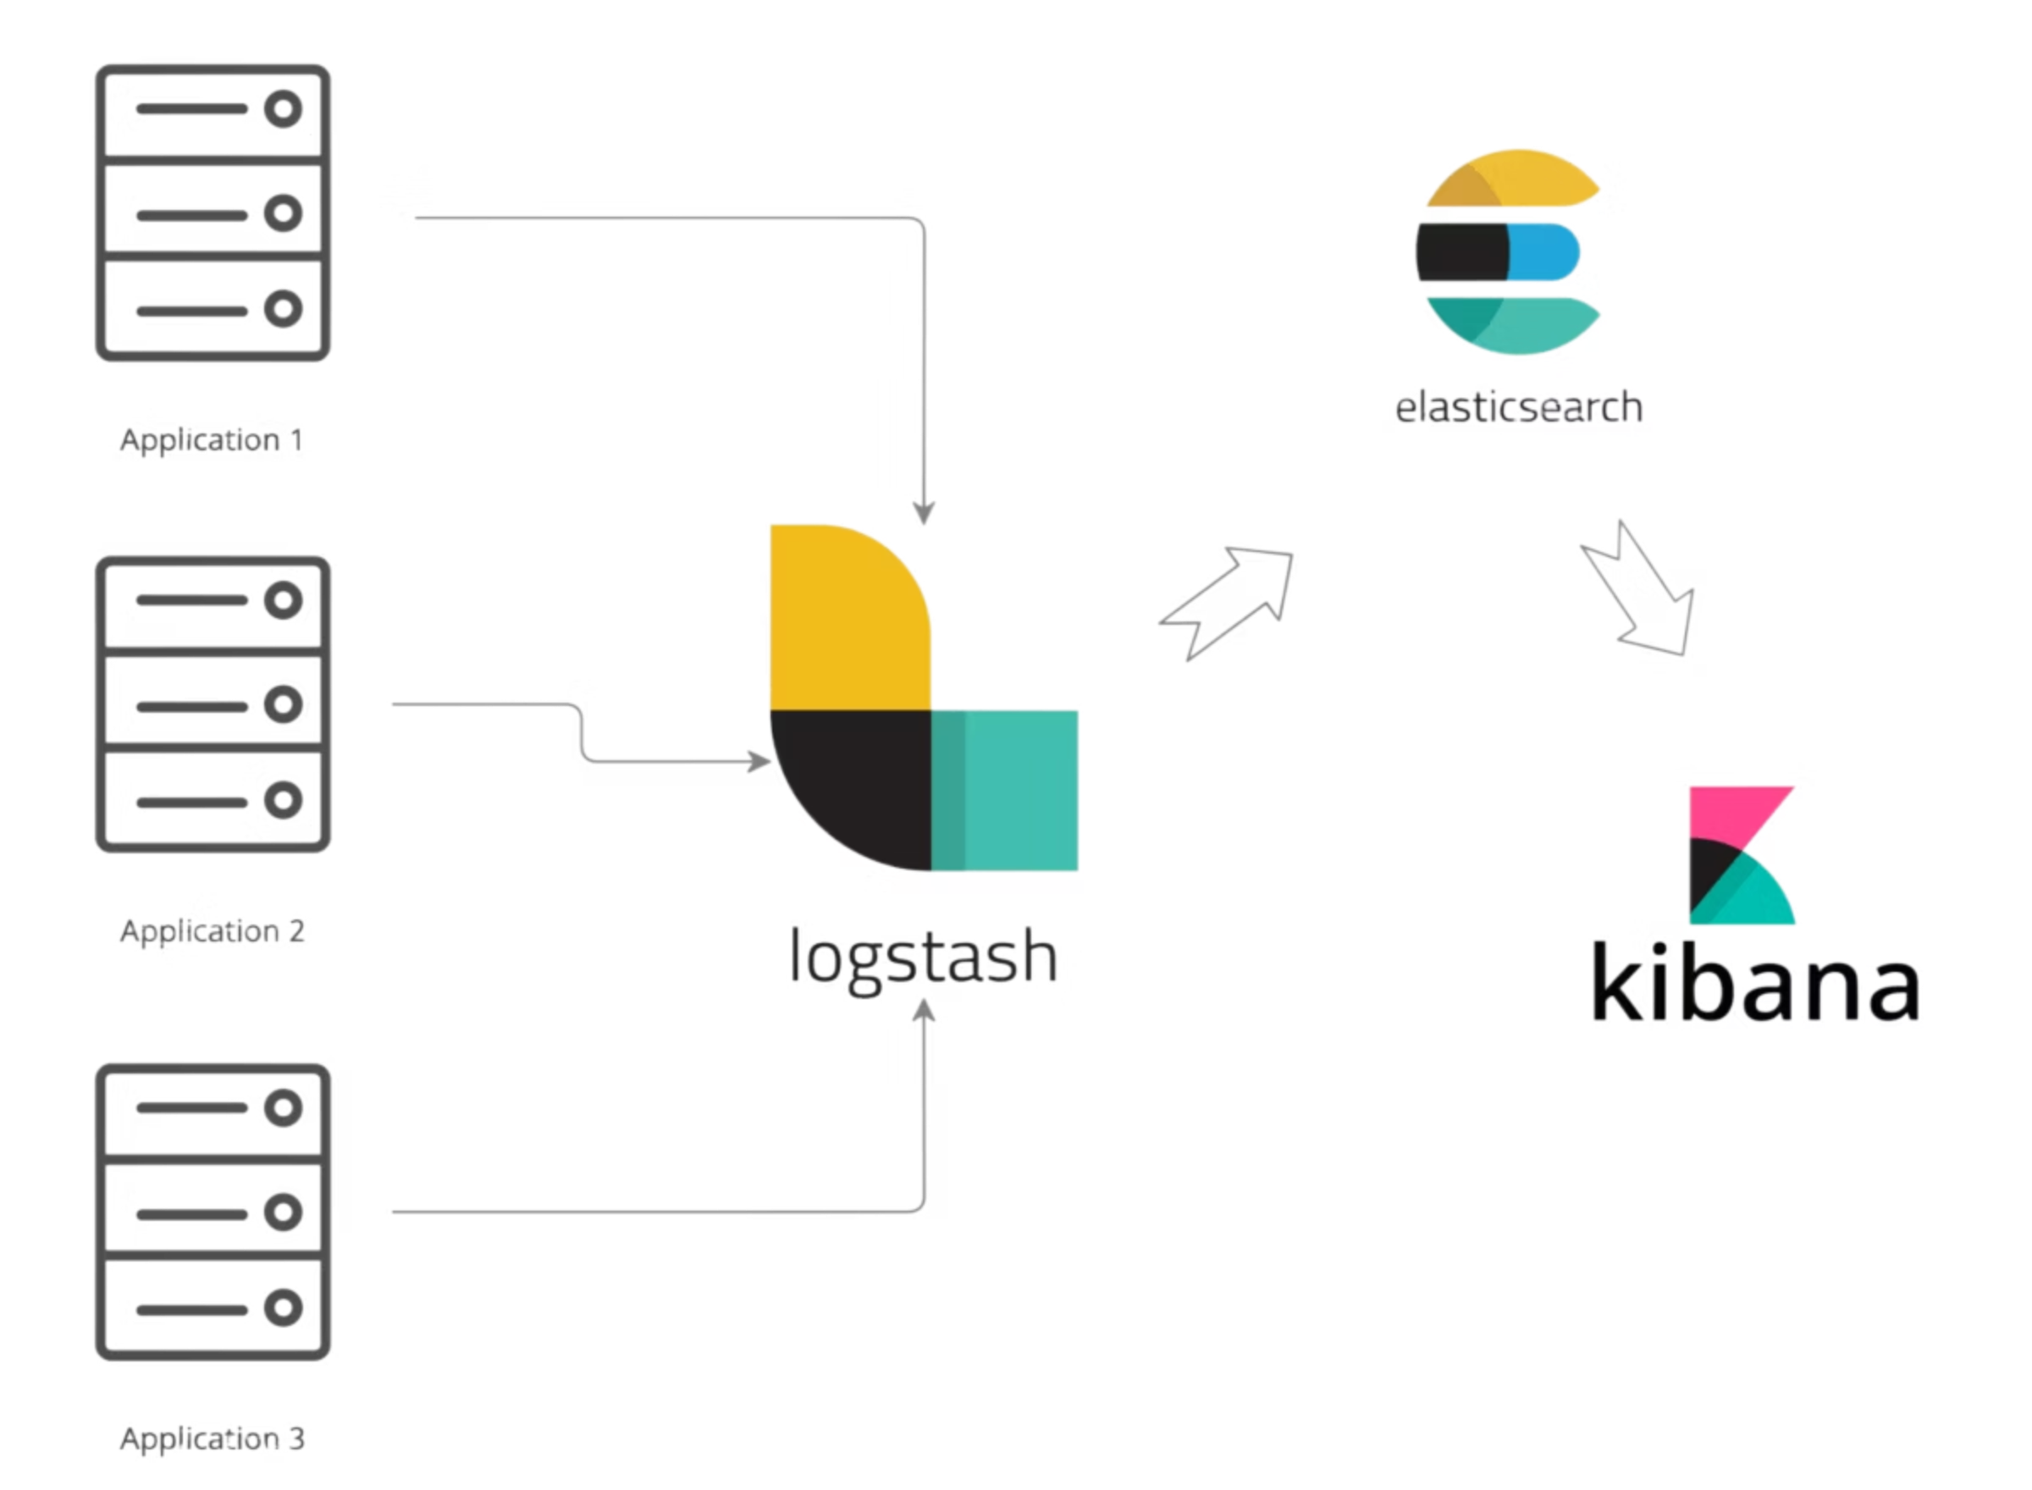



How ELK Stack Works
Log Generation
Applications and services generate structured or unstructured log data across your infrastructure.
Collection & Processing
Logstash collects logs from multiple sources, parses content, filters noise, and transforms data into a standardised format.
Indexing & Storage
Elasticsearch indexes processed logs and stores them in a distributed, scalable data store optimised for search.
Visualisation & Analysis
Kibana provides real-time dashboards, custom queries, and drill-down capabilities for rapid troubleshooting.

Slide 5


Logstash: The Data Pipeline
Flexible Data Collection
Logstash ingests logs from diverse sources including log files, databases, message queues, and APIs. Its plugin architecture supports over 200 input sources.
Intelligent Parsing
Extract structured data from unstructured logs using grok patterns, dissecting fields like user IDs, error codes, timestamps, and IP addresses.
Data Enrichment
Filter and transform raw data before indexing – add geolocation data, mask sensitive information, or drop irrelevant events.
Example: Convert an Apache access log line into structured JSON with parsed fields for HTTP method, status code, response time, and user agent.

Slide 6




Elasticsearch: The Search Engine
Real-Time Search
Execute full-text searches across billions of log entries with sub-second response times using inverted indices.
Distributed Architecture
Horizontally scalable across multiple nodes, ensuring high availability and fault tolerance for petabyte-scale data.
Advanced Analytics
Perform complex aggregations, filtering, and statistical analysis to uncover patterns and anomalies in your logs.
Example query: "Find all HTTP 500 errors in the last 24 hours where response time exceeded 2 seconds, grouped by service name."

Slide 7

Kibana: Visualisation & Dashboards
Real-Time Dashboards
Powerful Search Queries
Drill-Down Analysis
Build custom dashboards monitoring error rates, latency trends, user activity, and business metrics with automatic refresh.
Construct complex queries using Kibana Query Language (KQL) to filter logs by any field, timeframe, or pattern.
Click through visualisations to examine specific log events, trace requests across services, and identify root causes.
Security use case: Detect suspicious patterns such as repeated login failures from the same IP address, indicating a potential brute-force attack.

Slide 8
Benefits of ELK Stack
Centralised Management
Platform Agnostic
Aggregate logs from all applications, servers, and services into a single searchable repository.
Works with any technology stack – cloud, on-premises, containers, microservices, and legacy systems.
Flexible Analytics
Operational Excellence
Create custom dashboards tailored to your specific needs – from DevOps metrics to business intelligence.
Accelerate troubleshooting, optimise performance tuning, and strengthen security auditing capabilities.

